Slide 1
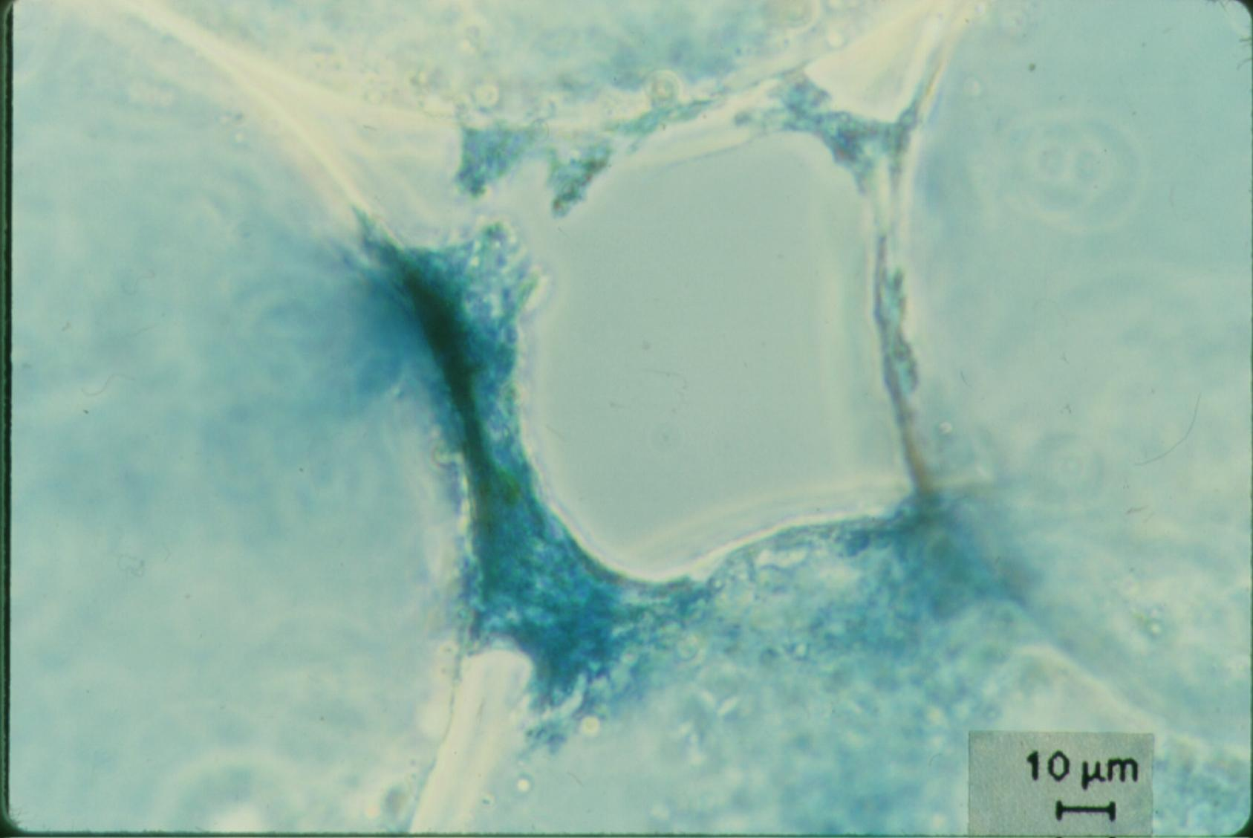
Filtration Theory
On removing little particles with big particles

Slide 2
Filtration Outline
Sand Filters
Slow sand (SSF)
Rough Gravel (RGF)
Dynamic Gravel (DGF)
Rapid (RSF)
Stacked Rapid (StaRS)
Range of applicability
Net Velocity
Hydraulics
Particle Capture theory
Transport
Dimensional Analysis
Model predictions
Methods to improve performance

Slide 3
Categorizing Filters
Surface filtration (slow sand & membrane filters)
Particles to be removed are larger than the pore size
Clog rapidly and large piezometric head required
Head loss increases faster and faster as pores clog
Depth filtration (rapid sand and stacked rapid)
Particles to be removed are much smaller than the pore size
Require that particles collide with and attach to the media
Can handle more solids before developing excessive head loss
Head loss increases at a constant rate
Require more energy
Our focus here

Slide 4
Sand Filtration Technologies
Slow (Filters→English→Slow sand→“Biosand”)
First filters used for municipal water treatment
Were unable to treat the turbid waters of the Ohio and Mississippi Rivers
Can be used after rough gravel filters to extend range
Rapid (Mechanical→American→Rapid sand)
Used in Conventional Water Treatment Facilities
Used after flocculation and sedimentation
High flow rates→clog 12 – 90 hr→hydraulic cleaning
Stacked Rapid Sand (StaRS)
6 x smaller than rapid sand and self backwashing
scrape
backwash
“Biosand” is a misnomer based on a misunderstanding of SSF mechanisms. The preferred term is intermittent SSF (ISSF)
Notes:
If you have water in a muddy river and you can only use 2 processes for treatment prior to chlorination, which processes would you choose?

Slide 5


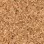
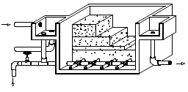
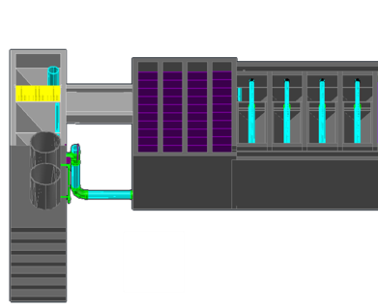
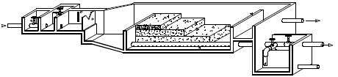
Filter range of applicability The “if it is dirty, filter it” Myth
SSF
RSF+
StaRS+
Filter performance depends on pretreatment
1
10
NTU
100
With a floc blanket to extend range
1000
Notes:
https://confluence.cornell.edu/download/attachments/90755680/FiME+CINARA.pdf for info on SSF and multistage

Slide 6
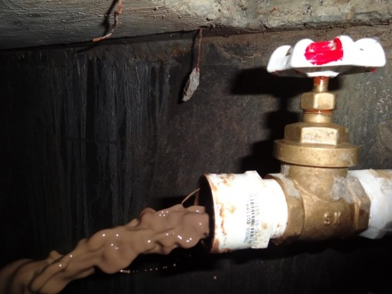
Floc/Floc blanket/Plate settlers do the hard work
The amount of water wasted from each unit process is determined by the solids concentration of wasted water.
The goal is to minimize volume of wasted water: therefore maximize solids concentration of waste
Backwash water is less concentrated than floc hopper waste
Goal is to minimize solids entering filter!
Backwash water can be reprocessed, but that requires a pump (a good option to explore for dry season water saving)
Notes:
Estimate of backwash waste from Water Quality and Treatment: A Handbook of Community Water Supplies. 5th ed. AWWA

Slide 7
Combining Rapid Sand Filtration and pretreatment
AguaClara: Flocculation – Floc Blanket – Settle – Filter
Able to treat very high turbidities because filter is the polishing step
Effluent from sedimentation should be less than 2 NTU (and much lower is much better)
Conventional: Flocculate – Settle – Filter
Same as above
Direct: add Coagulant and then Filter
An option if raw water turbidity is always low
less than 5 NTU

Slide 8
Slow Sand Filtration
First filters to be used on a widespread basis
Fine sand with an effective size of 0.2 mm
Low flow rates (0.03-0.12 mm/s)
Schmutzdecke (_____ ____) forms on top of the filter (surface filtration)
causes high head loss
must be removed periodically
Used without coagulation/flocculation!
Turbidity should always be less than 10 NTU with a lower average to prevent rapid clogging
Compare with sedimentation
filter cake
Notes:
See page 8.77 in Water Quality and Treatment: A Handbook of Community Water Supplies. Fifth edition.
This is the default technology that has been widely touted as the best option for the global south. However failures and abandonment are common.

Slide 9
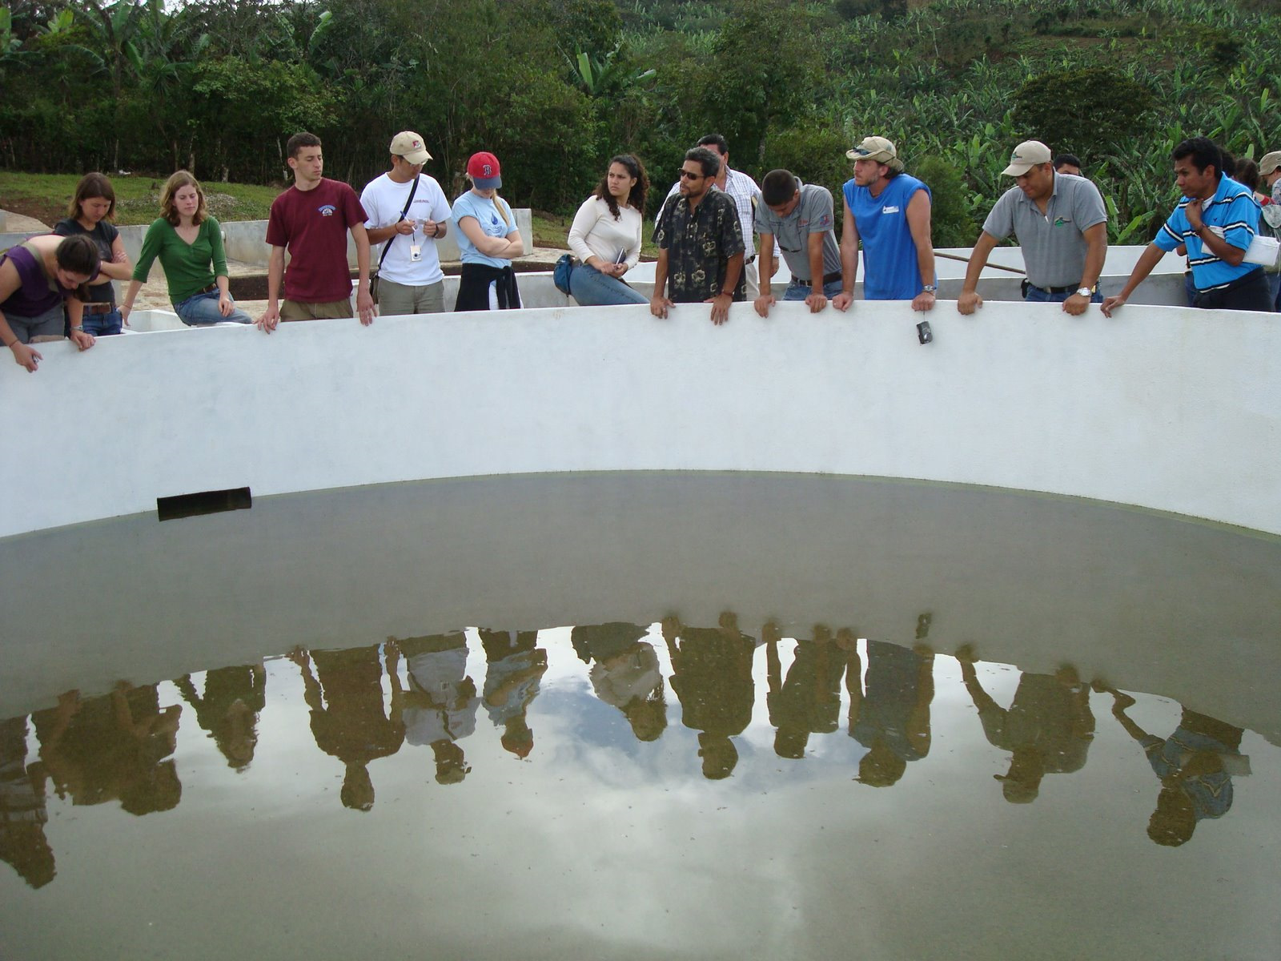
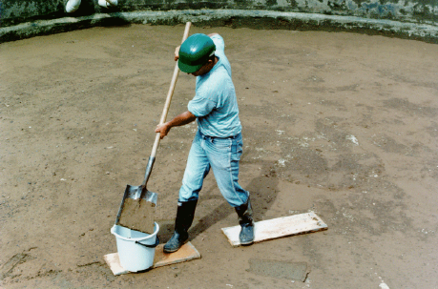
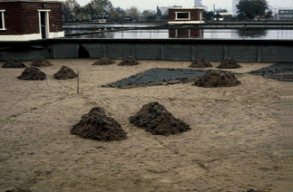
Slow Sand Filter
Notes:
Part of a multiple stage filtration plant in San Pedro de Tutule, Honduras.

Slide 10
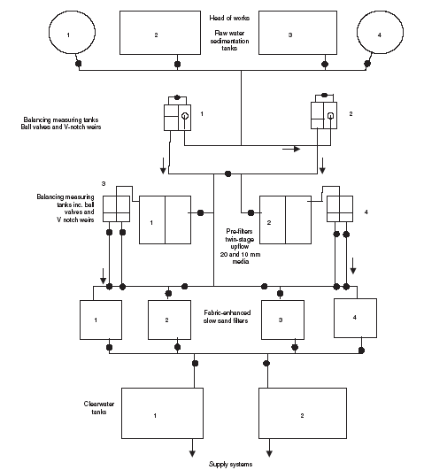
Multistage Filtration is a land and capital intensive option
Another option for communities using surface waters
Uses no coagulants (if lucky)
Gravel roughing filters
Polished with slow sand filters
Large capital costs for construction
No coagulant costs
Labor intensive operation
Notes:
http://www.atypon-link.com/TELF/doi/pdf/10.1680/wama.157.3.143.46664

Slide 11
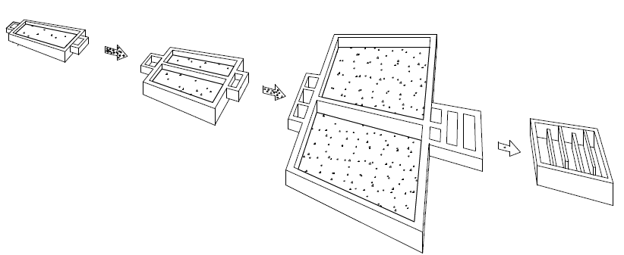
Multiple Stage Filtration
Dynamic
DGF
Rough
RGF
Slow
SSF
Disinfection
Clogs and shuts down plant during high turbidity event
Reduces turbidity so SSF doesn’t clog so fast

Slide 12
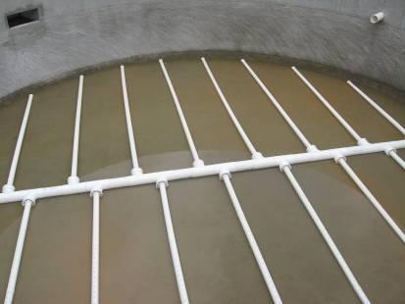
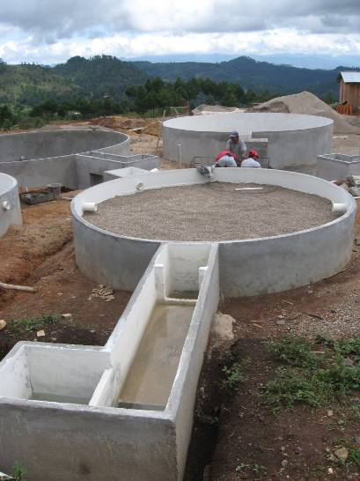
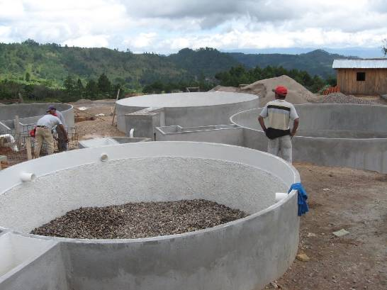
Assembling Multiple Stage Filters
Notes:
San Pedro de Tutle FIME plants

Slide 13
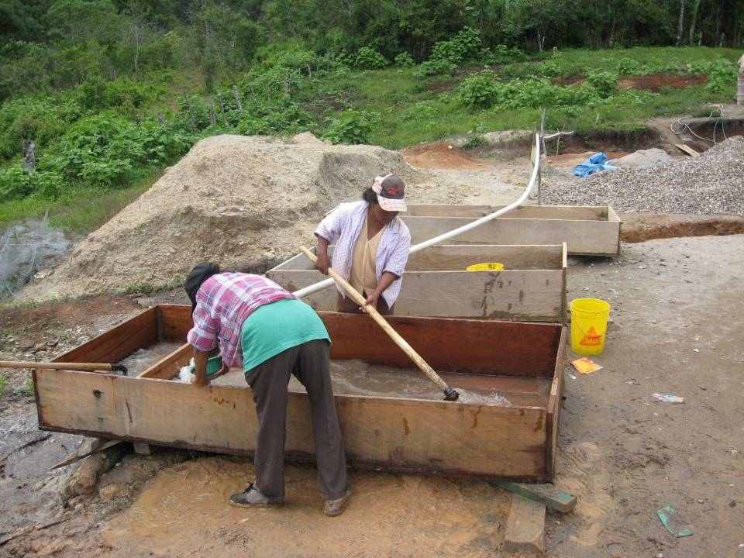
Notes:
San Pedro de Tutle FIME plants

Slide 14
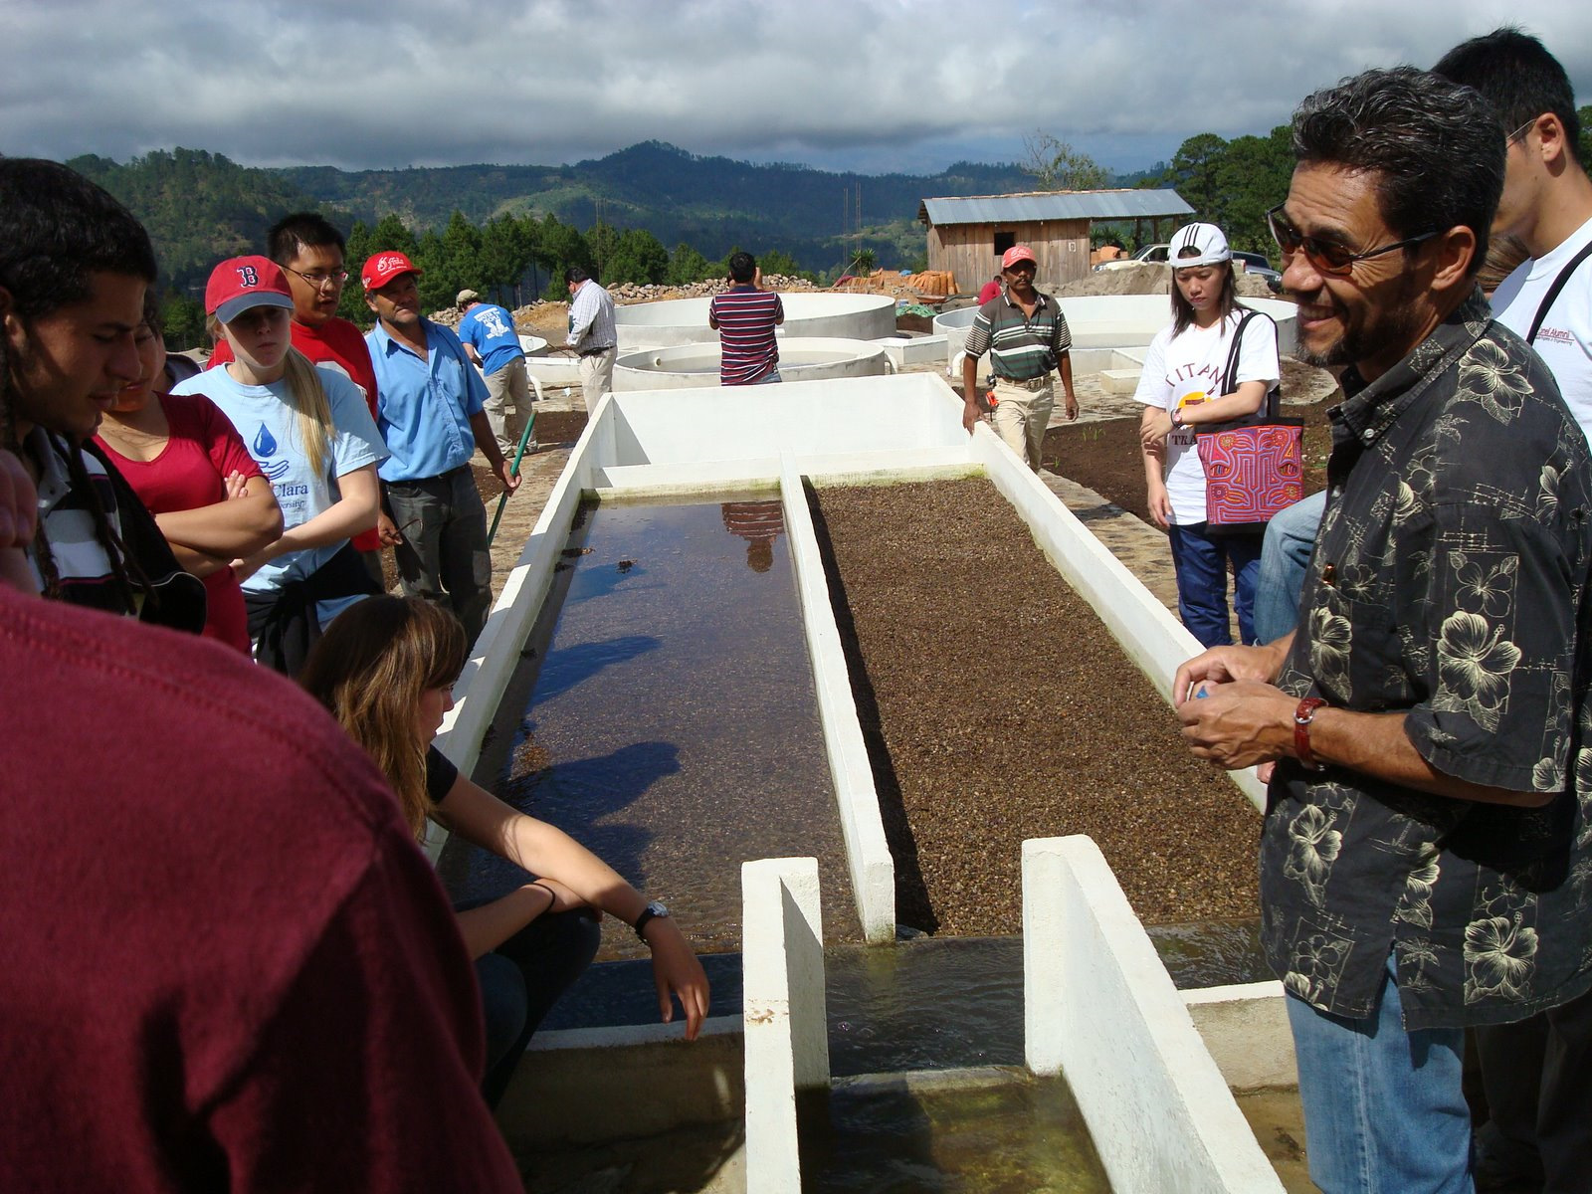
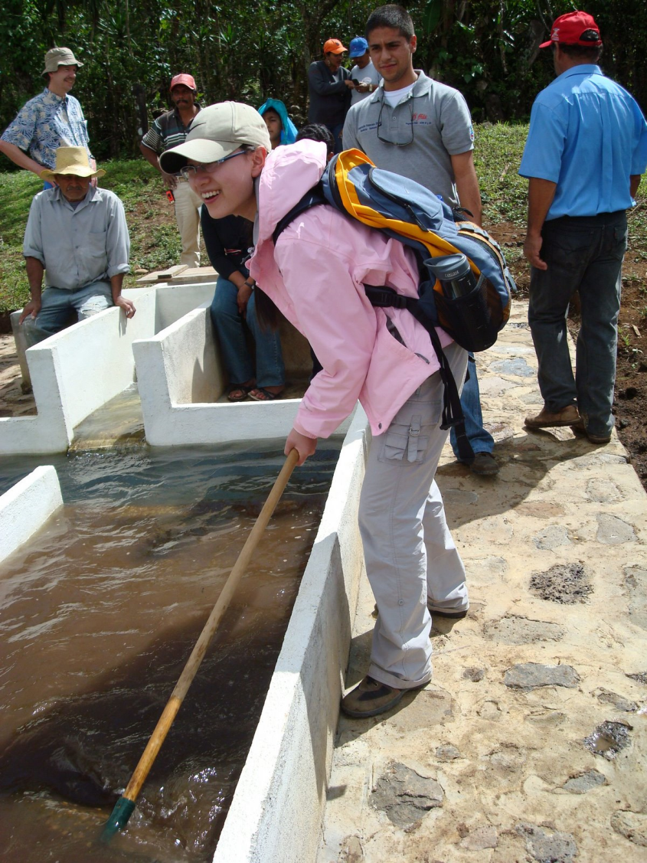
Slow Sand
Roughing
Dynamic Filter

Slide 15
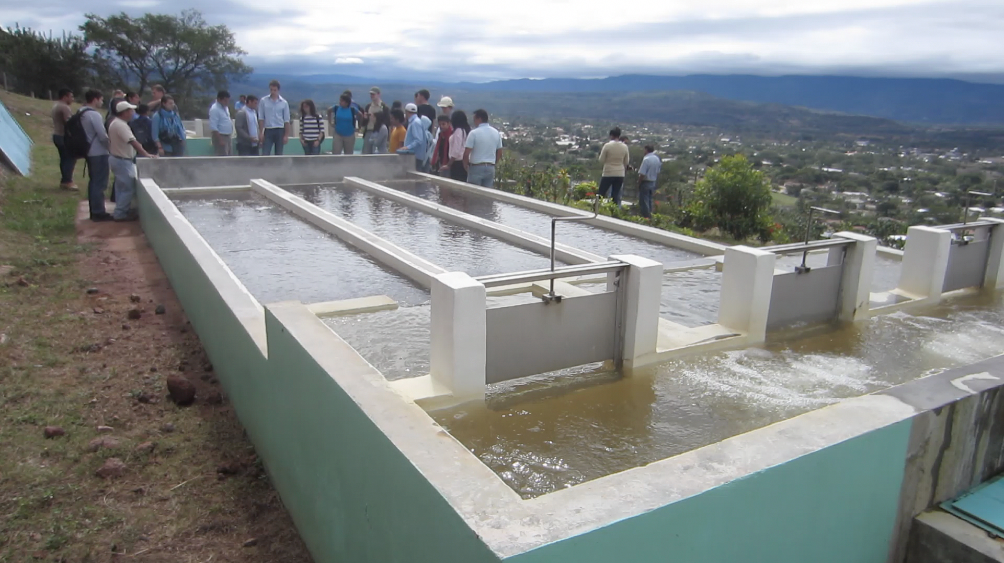
Jesus de Otoro, Honduras: Dynamic Filters

Slide 16
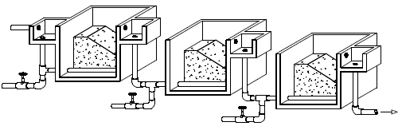
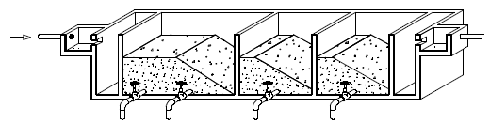
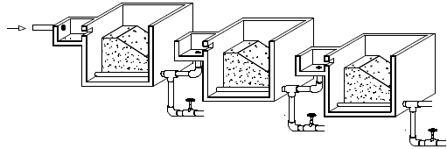
Multiple Stage Filtration Options for pretreatment for SSF
Dynamic filter (clogs to shutdown plant)
Filters in series with different size media in each filter
Up flow gravel filter with multiple layers
Best option here is dynamic + Up flow with layers
Notes:
https://confluence.cornell.edu/download/attachments/90755680/FiME+CINARA.pdf
See section 4.3 for hint that the drainage system is the piece that requires further research. This suggests that they may still be having difficulty cleaning the sediment from these filters. Note that these filters are not easily disassembled for maintenance and thus do not meet the specifications for easy maintenance required for AguaClara plants.

Slide 17
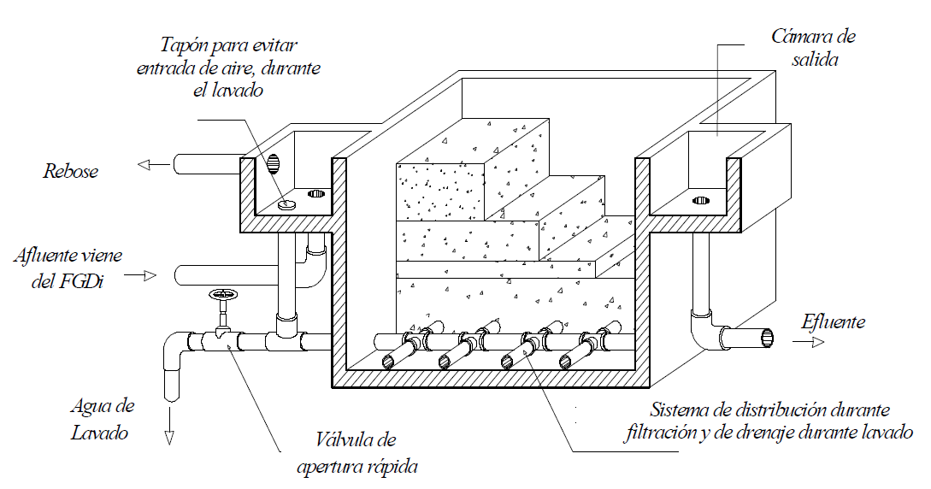
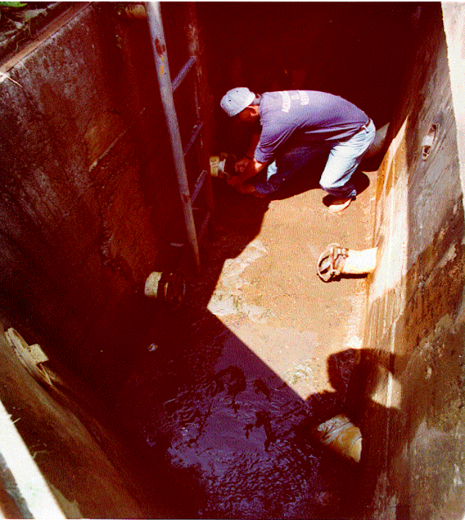
Up flow Roughing filter
0.08 to 0.17 mm/s
50x
5.5 mm/s during wash
Turbidity removal is between 50% and 90%
Exit chamber
Cap to prevent air entrance during washing
overflow
D = 1.6 – 3 mm
D = 3 - 6 mm
From dynamic filter
D = 6 - 13 mm
D = 13 - 19 mm
D = 19 - 25 mm
Effluent
2 m long
Wash water
Rapid opening wash valve
Manifold system
Cleaning, Impossible fittings, Maintenance, Water exit?
Notes:
https://confluence.cornell.edu/download/attachments/90755680/FiME+CINARA.pdf Figure 9.1

Slide 18
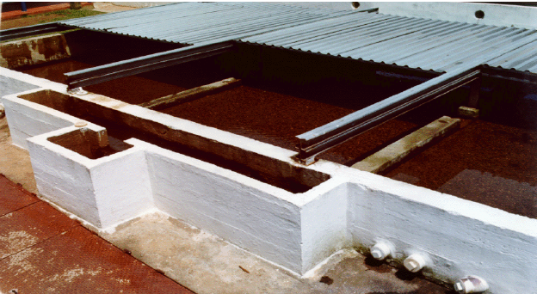
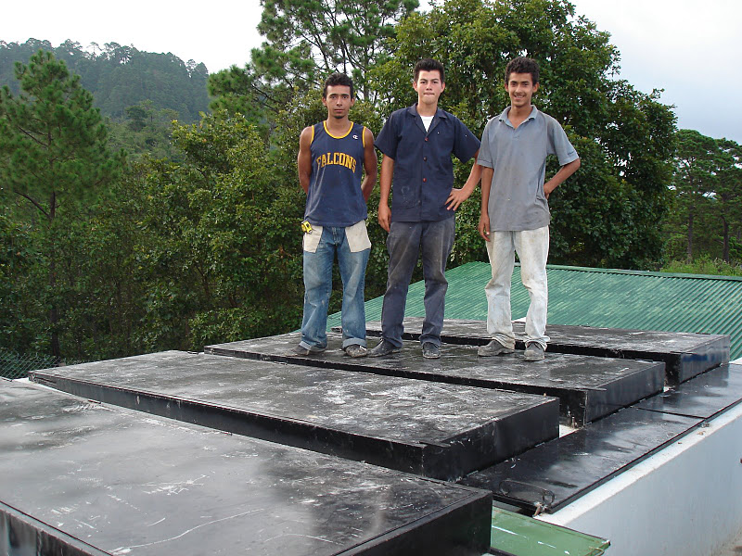
First iteration of covering a roughing filter…
Covered to reduce growth of algae. What is the next logical step?
Notes:
https://confluence.cornell.edu/download/attachments/90755680/FiME+CINARA.pdf

Slide 19
System Comparison: Multistage vs. AguaClara water treatment
Multistage has more expensive hardware (many large valves) and requires 10 to 20 times more land area
Multistage doesn’t use coagulants
Multistage performs poorly with turbid water
When might multistage be better than AguaClara?

Slide 20
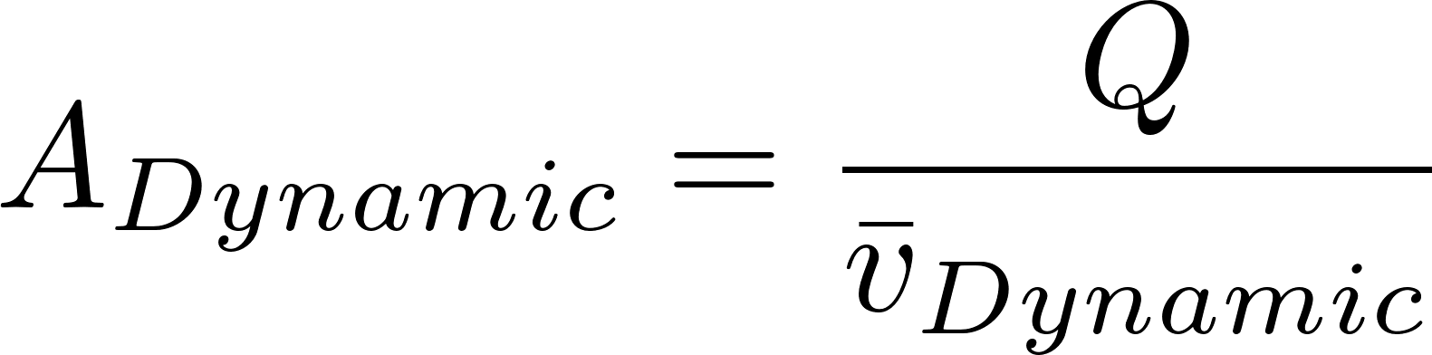
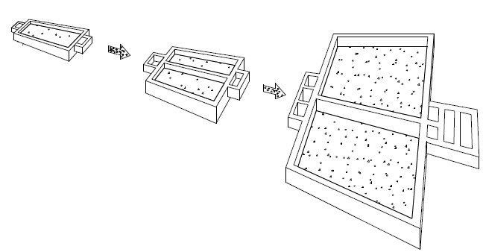
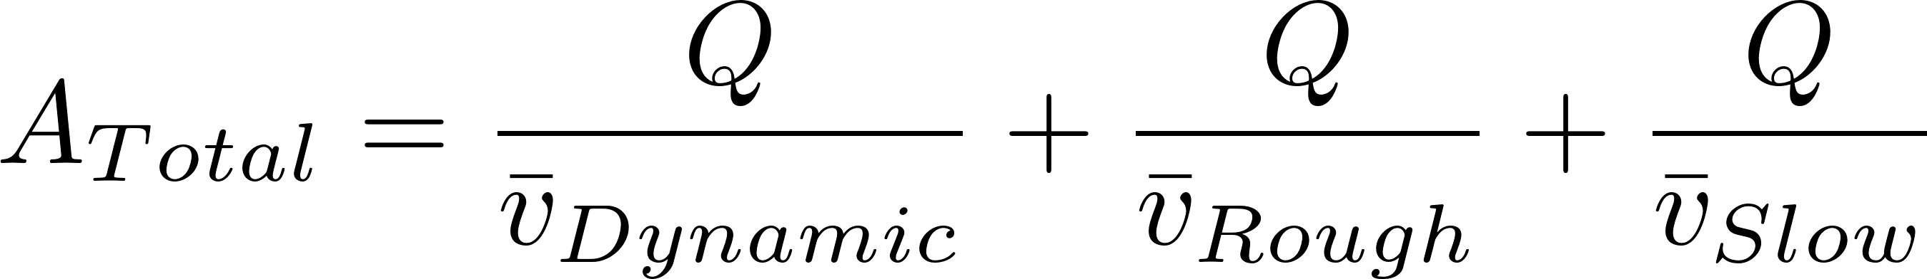
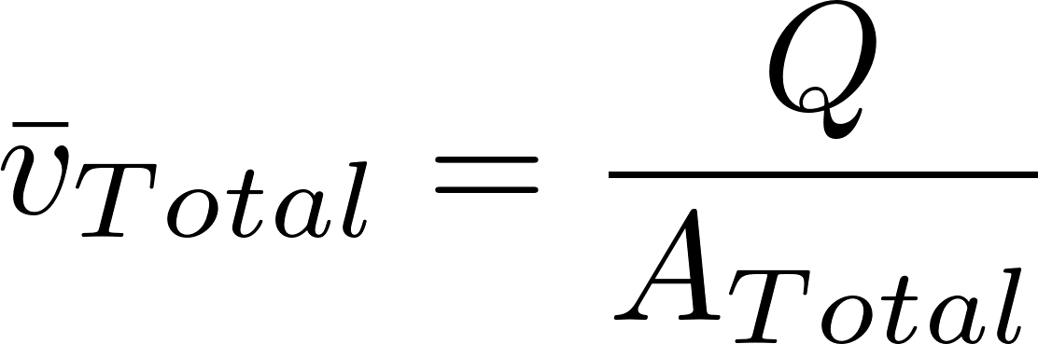
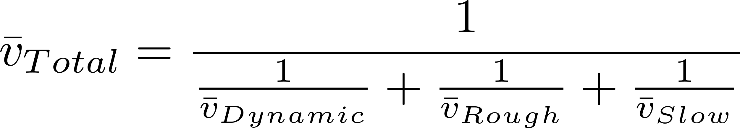
Net Velocity Concept for estimating plant size
Always check the velocity of unit processes to see if they are going to be cost effective
Use this velocity to determine approximate total unit process area.
Similar approach for sizing any facility for comparison
This term dominates

Slide 21
Filter type | Velocity (mm/s) | Cleaning | Max (NTU) | pC* | Area (m²) for 1 L/s
Dynamic | 0.4 |  |  | 0 | 2.5
Roughing¹ | 0.17 | 5.5 mm/s downflow |  | 0.5² | 5.9
Slow | 0.04 | Scrape surface | 10 | 0.8² | 25
Multistage | 0.03³ |  | 100⁴ | 1.3 | 33.4
Rapid | 0.7 – 2.8 | 11 mm/s backwash | 5⁵ | 1 | 0.55
Entrance | 8 |  |  |  | 0.125
Flocculation | 4 |  |  |  | 0.25
Sedimentation | 1 |  |  | 2.5 | 1
Floc Hopper | 5 |  |  |  | 0.2
Stacked Rapid | 1.8 x 6 | 11 mm/s backwash | 3⁶ | 1⁶ | 0.093
AguaClara | 0.6³ |  | 1000⁵ | 3.5 | 1.67
1 Roughing is up flow in layers
2 Based on table 5.7 https://confluence.cornell.edu/download/attachments/90755680/FiME+CINARA.pdf
3 Net velocity for scaling total plan view area of facility.
4 This assumes a target of 5 NTU in the effluent
5 Assumes a target of 0.3 NTU in the effluent (based on performance of the Atima plant)
6 Data from Tamara.
The 32 L/s plant at San Nicolas has 5.5 m² per L/s = 0.18 mm/s (includes chemical room, bathroom, office)
Notes:
Based on table 5.7 of https://confluence.cornell.edu/download/attachments/90755680/FiME+CINARA.pdf
Note that areas don’t include controls, entrance tanks, walkways, etc.
Flocculator is 2 m deep and residence time is about 500 s.
The 32 L/s plant at San Nicolas has 5.5 m^2 per L/s

Slide 22
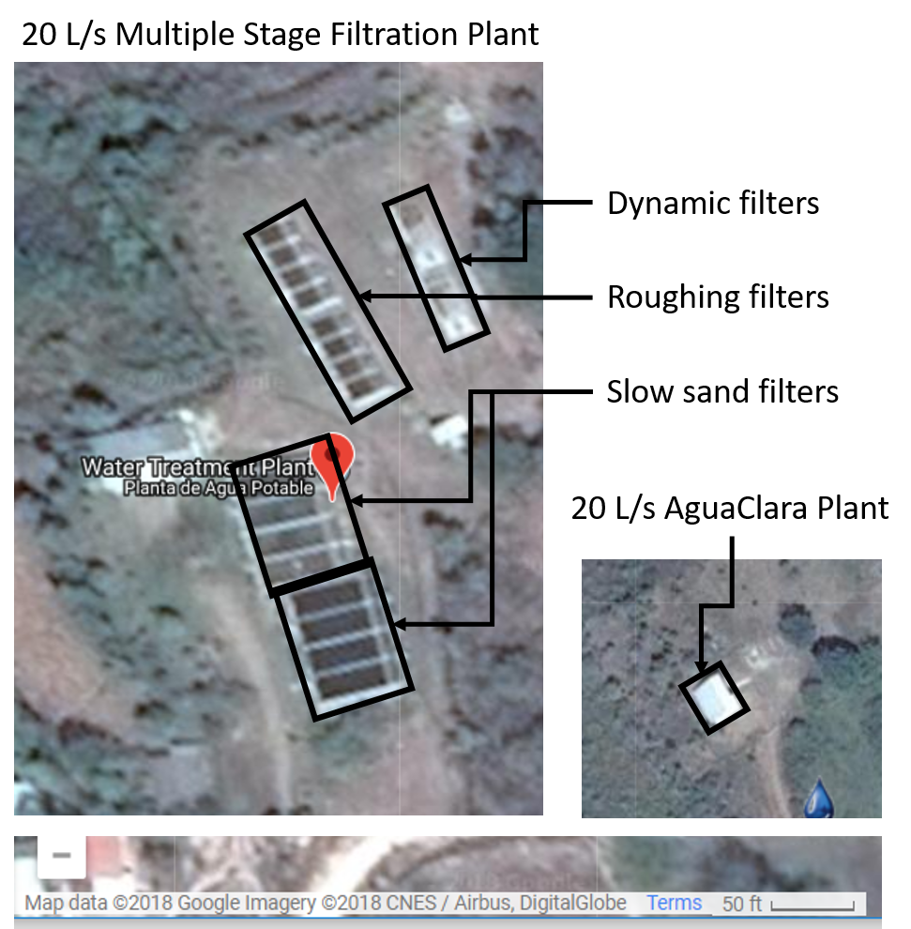
A factor of 20 matters!

Slide 23
Rapid Sand Filter (Conventional US Treatment)
Size
(mm)
0.70
0.45 - 0.55
5 - 60
Specific
Gravity
1.6
2.65
2.65
Depth
(cm)
30
45
45
Anthracite
Influent
Sand
Gravel
Drain
Effluent
Wash water

Slide 24
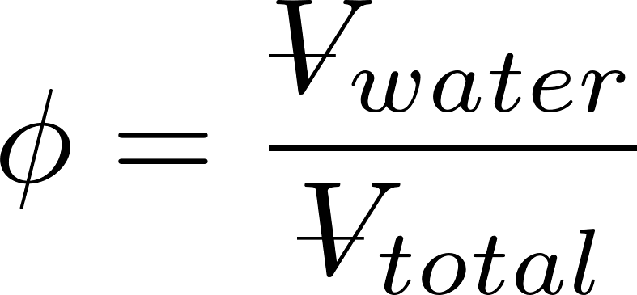
Rapid Sand Filter Design
Filter media
silica sand and anthracite coal
non-uniform media will stratify with _______ particles at the top
Filtration approach velocities
0.7 – 2.8 mm/s
Backwash approach velocities
set to obtain a bed porosity, φ, of 0.65 to 0.70
Fluidized bed
smaller
Does water speed up or slow down when it enters the sand?
Similar in size to AguaClara Sed (1 mm/s)

Slide 25
Backwash (Fluidized Bed)
Wash water is treated water!
WHY?
Anthracite
Sand
Only clean water should ever be on effluent side of filter!
Influent
Gravel
Drain
Effluent
Wash water
Notes:
https://www.youtube.com/watch?v=9tqk2cFDi5o#t=226

Slide 26
Filter Hydraulics
Porosity
Sand size definitions
Clean bed head loss estimates
Backwash requirements
Low flow design challenges: the backwash dilemma

Slide 27
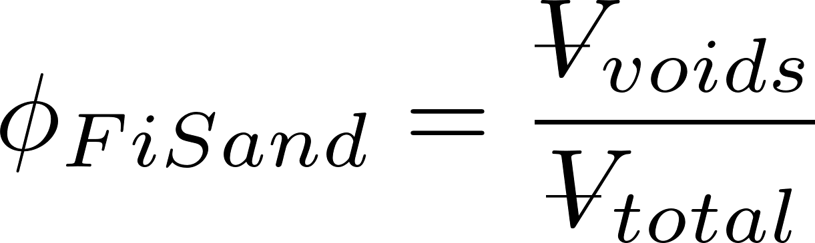
Porosity
volume of voids
total volume
Example: 1 m³ of dry aquifer material weighed 1600 Kg. The aquifer material was then saturated with water and found to weigh 2000 Kg.
What is the porosity of the aquifer material?
What is the bulk density of the aquifer material?
What is the density of the aquifer material?
0.4
1600 kg/m³
2700 kg/m³

Slide 28
Porosity
Which will have the greatest porosity?
1 µm diameter clay
0.2 mm diameter sand
1 cm diameter gravel
You have been given 100 kg each of clay, sand and gravel
What could you do to create the lowest porosity?
100 kg gravel, 100*0.4/0.6 kg sand, 100*(0.4/0.6)² kg clay
Notes:
100 kg, 67 kg, 44 kg

Slide 29
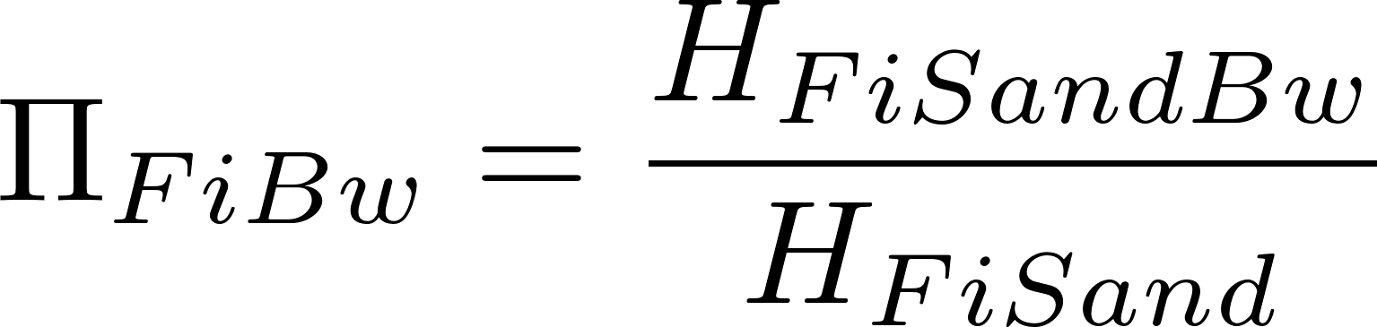
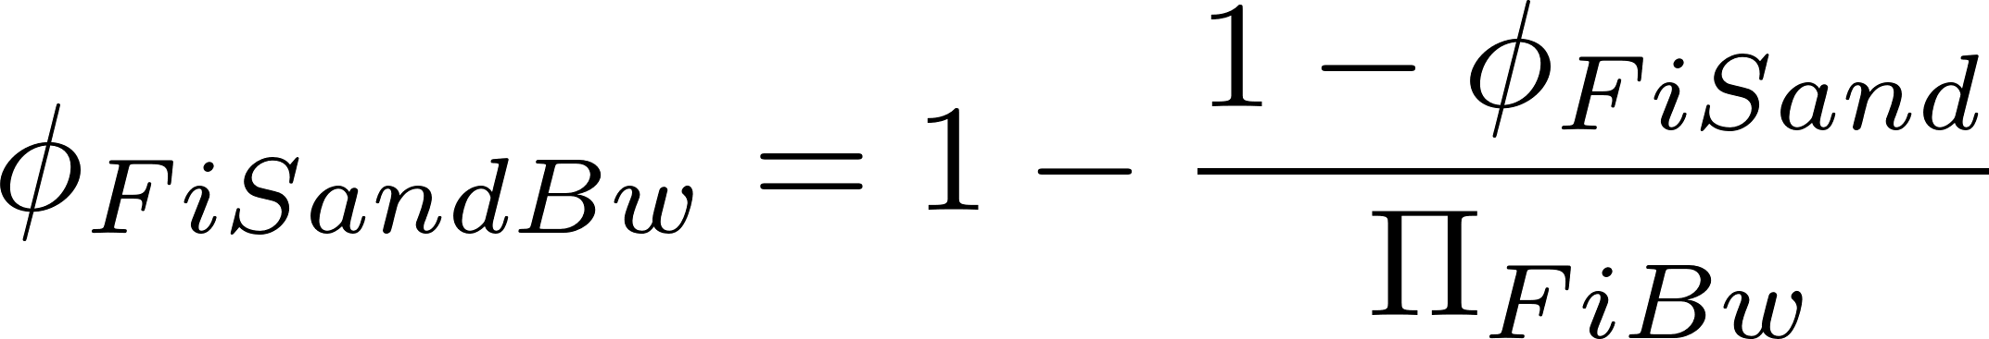
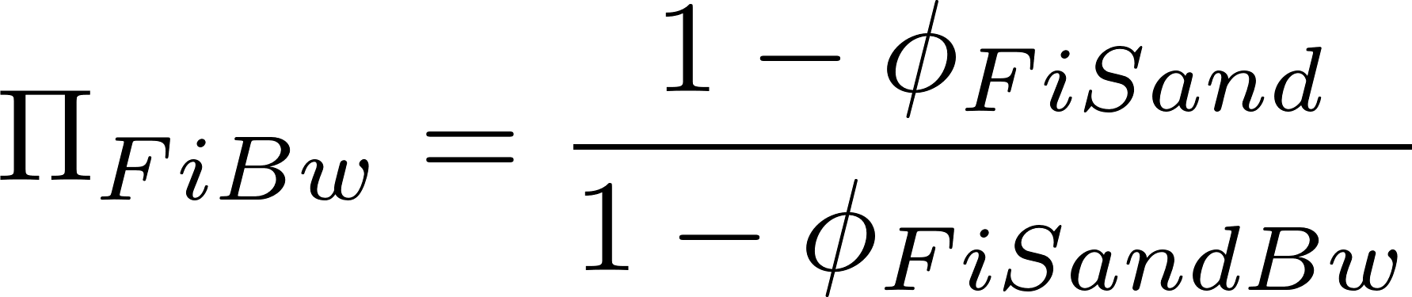
Expanded Bed Porosity
Filter expansion ratio
Backwash porosity
Pore volume + volume above bed = Expanded bed pore volume
Total expanded volume
Now we can relate porosity and filter expansion ratio
Notes:
Sand fraction * height of sand is conserved!

Slide 30
Sand Grading
Effective Size
D₁₀ - sieve size that 10% by mass of the sand passes through
Used for filter particle removal modeling
D₆₀ – sieve size that 60% by mass of the sand passes through
Used for hydraulic modeling
Uniformity Coefficient = D₆₀/D₁₀

Slide 31
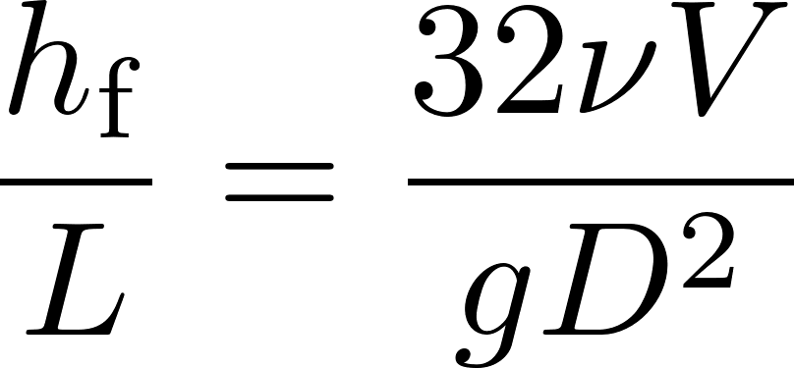
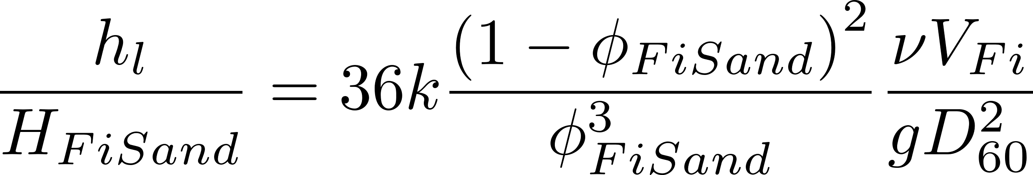
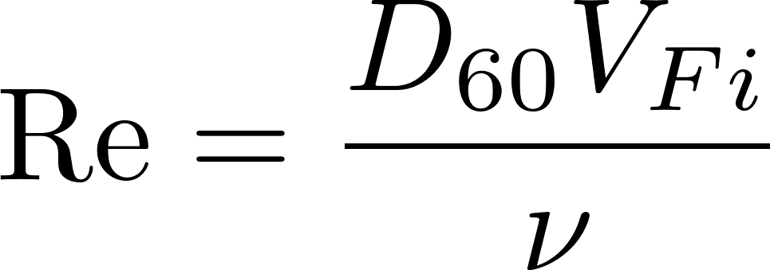
Clean Bed Head Loss (Karmen Kozeny)
Hagen Poiseuille
Porosity (0.4 for uniform size media)
Kinematic viscosity
Approach velocity
Head loss
Sand diameter
Flow path length (filter bed depth)
Kozeny constant
Approximately 5 for most filtration conditions
Assumes laminar flow and is valid up to Re of 6
Notes:
Karmen Kozeny valid up to Re of 6
Page 8.10 in Water Quality and Treatment: A Handbook of Community Water Supplies. Fifth edition.
What happens if we have an upflow RSF and we gradually increase the filtration velocity? At some point (to be determined) the pressure difference will be enough to lift the entire sand bed!

Slide 32
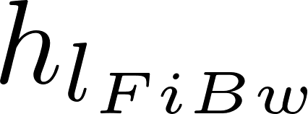
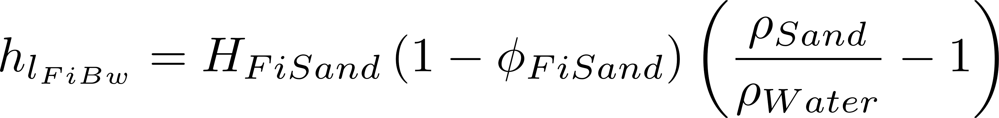
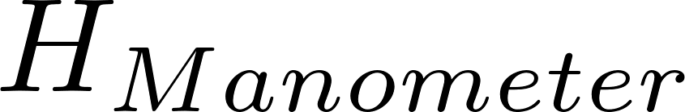
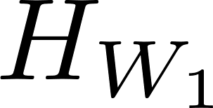

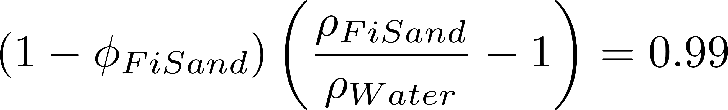
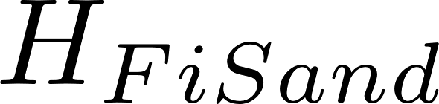
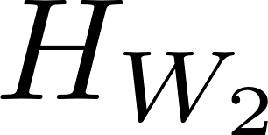
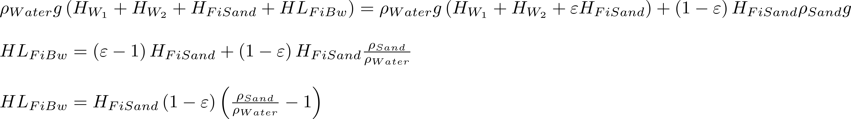
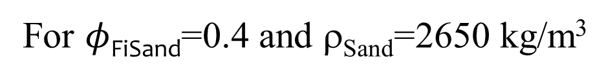
Backwash Requirements – Head Loss (force balance)
Weight of water/Filter area
Weight of sand/Filter area
=
For $φ$_{FiSand}=0.4 and ρ_{Sand}=2650 kg/m³
Notes:
The pressure drop times the filter area is equal to the buoyant weight of the sand grains.

Slide 33
What does this analysis miss?
Sand bed may first lift as a unit and then fall into the fluidized state
Wall shear (scale effect!!!!) and embedded pipes may prevent bed lift (or require more force than our simple force analysis suggests)
Sand will stratify if there is even a small range of sizes: Backwash velocity must be sufficient to fluidized the largest sand
Backwash initiation requires more study
Notes:
Also! Dirty sand has more head loss!

Slide 34
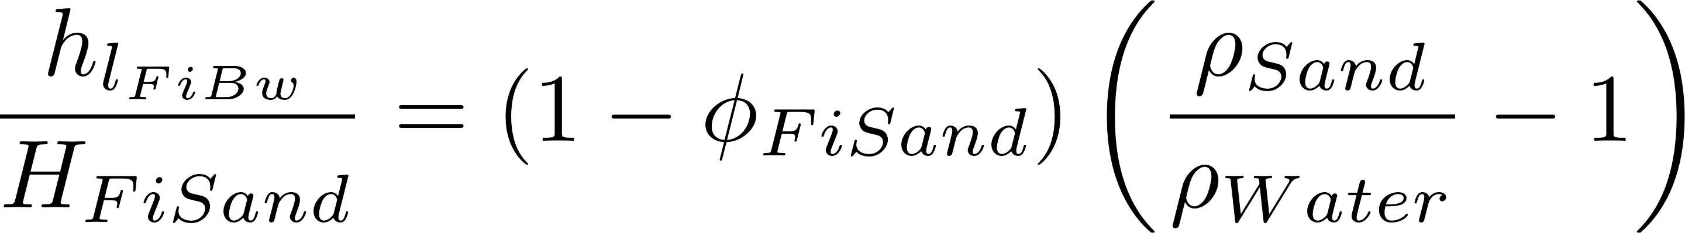
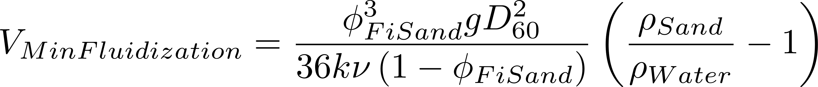
Backwash Requirements – Flow Rate
Kozeny
Backwash Head Loss (force balance)
Set them equal
Minimum approach velocity required to fluidize bed
Notes:
Using D60 might not be conservative enough.

Slide 35


Backwash Velocity
Π_{FiBw} is expanded bed depth over settled bed depth
(Effective size)
0.45 mm E.S. with 1.65 U.C. = D₆₀ 0.72 mm
Fluidize at 5 mm/s
30% bed expansion at 12 mm/s
Notes:
This seems a bit of a stretch because we are starting with pipe flow equations. It might be better to switch to sphere sedimentation equations.
Karmen Kozeny valid up to Re of 6
Page 8.10 in Water Quality and Treatment: A Handbook of Community Water Supplies. Fifth edition.

Slide 36
Backwash sand bed stratification
Suppose the sand stratifies in the filter bed during backwash and suppose that 10% of the bed is smaller than 0.4 mm and 10% of the sand is bigger than 0.8 mm
What is the ratio of fluidization velocity for the top of the sand bed to the fluidization velocity for the bottom of the sand bed?
Notes:
Sand at top has a diameter that is ½ of the sand at the bottom. Therefore velocity to fluidize the top will be ¼ of the velocity required to fluidize the bottom. Thus seeing sand fluidize at the top of a filter bed does not guarantee that it is fluidized at the bottom.

Slide 37
First identify a need, then invent
Slow sand – capital and labor intensive
Rapid sand – require pumps for backwash or require 6 filters working together
Neither of these are good options for small communities
Invent time!

Slide 38



The Backwash Dilemma
Backwash velocity >> filtration velocity
Backwash water must be clean water
Backwash water sources?
Pump it from clearwell
Set of filters working in parallel to backwash one filter
Filtered water stored at adequate elevation

Slide 39




Rapid Sand Filter Set: Backwash without pumps
What are these two valves controlling? Reverse engineer the universe!
https://confluence.cornell.edu/display/AGUACLARA/Santa+Rosa+de+Copan

Slide 40


The Low Flow Challenge: Filter Set
Assume plant flow is 6 L/s, Filtration velocity is 1.8 mm/s and backwash velocity is 9 mm/s and that a set of filters will backwash one filter
How many filters?
Total filter area?
What happens if the plant is operating at half capacity (drought conditions)?
Need filters to be smaller to be able to backwash one!

Slide 41

Store filter water?
Try two filters and recalculate
Require a large tank and the tank must be shallow to keep filters from being really deep.
Filters need to be able to load the tank during filtration and then take water from the tank during backwash. This is accomplished by having the filter water level VERY high during filtration and low during backwash
Would increase AguaClara plant size by 50%! Vnet for entire plant is 0.18 mm/s
Notes:
Fails the ridiculous test as named by Mickey Adelman
Identify filtration head loss and backwash head loss

Slide 42
The Low Flow Challenge
Requiring 6 filter boxes for a small plant is too costly and difficult to construct and maintain.
Storing filtered water requires a storage tank with a V_{up} less than the entire AguaClara plant!!!
If we rule out the pump option, then we have no good options…

Slide 43
Why is this difficult?
The backwash dilemma is due to the big difference between backwash flow rates and filtration flow rates
6 filters are required if backwash velocity is 5 times the filtration velocity
If we could get those velocities to be similar or equal, then we wouldn’t need a set of 6 filters
Invention time
Notes:
Brainstorm ways to get those velocities to be similar!
Decrease media density so it fluidizes at a lower velocity
Decrease media diameter so it fluidizes at a lower velocity (but that will increase head loss during filtration mode too)
Make a more compact filter. (filter in parallel, backwash in series!)

Slide 44



Geometric Trick: Stacked Rapid Sand Filter (StaRS)
Instead of 6 filters side by side, stack them up!
Reduce backwash water volume by factor of number of layers
Notes:
Optimal number of layers is a function of backwash requirements and optimal filtration velocity. We are using shallower filter beds than conventionally used and thus filter performance is expected to be poorer.

Slide 45
Water Source for Backwash
Tradition says Filtered Water
Why not use Settled water?
Public Health trade off?
Filter to waste after backwash is required in any case due to contamination of manifold tubing
Use of settled water significantly simplifies the system
Same flow rate and water source during filtration and backwash!!!!
Eliminate empty clearwell failure mode

Slide 46



StaRS Filter Fabrication
San Matías construction
Backwash operation

Slide 47

Pipe Gallery (San Nicolas)

Slide 48
Eliminating 7 big valves: One valve control of a StaRS Filter
The following slides illustrate the method of using a siphon tube to initiate backwash
The filter animation only shows how the siphon will work. It doesn’t show how the inlet and outlet manifolds will be controlled
The Filter Inlet and Outlet control boxes will be designed so that water level changes* during backwash will cause all of the manifold pipes to be hydraulically separated and thus no valves will be required to turn off the inlet or outlet pipes
Notes:
*This will require a slight increase in the depth of the filter to accommodate a larger change in water levels between filtration and backwash

Slide 49
Begin Filtration

Slide 50

Begin Backwash
Notes:
Need to analyze the beginning of the siphon right after the air pressure is equalized with atmospheric pressure. It appears that we may need the height of water above the top of the siphon tube to equal the depth of submergence of the end of the siphon to initiate flow through the siphon

Slide 51
End Backwash

Slide 52

The big flush
Patent US2017263 - FLUSHING APPARATUS - Google Patents
Notes:
Patent US2017263 - FLUSHING APPARATUS - Google Patents

Slide 53

End Backwash cycle
What is the head loss through the sand bed + plumbing?
Constraints on depth of water in inlet box during backwash?
What is the head loss in the sand bed between an inlet and an outlet?
Notes:
Backwash water level must be high enough to not pull air into the filter and low enough to not flow into the other inlets.

Slide 54



Head loss between manifolds Assume expansion ratio of 1.3
Find depth of settled sand in 20 cm of expanded sand
Settled depth
Expanded depth (20 cm)
This is head loss per 20 cm of expanded bed!

Slide 55
Begin Filtration cycle
Inlet plumbing head loss
Outlet box
Total filter head loss

Slide 56
End Filtration cycle
Outlet box
Total filter head loss
What causes water to flow through the filter bed?
____________________________
differences in piezometric head
Notes:
Does gravity matter?
Apply the energy equation.
What must be true about the head loss for each parallel path?
What is the ratio of flows that the bottom inlet must be able to handle? If the head loss in the bottom inlet system is 10 cm during filtration, then what would it be during backwash?
What does this say about the head loss in the inlet system during filtration?
What must be true about the head loss in the pipe inlets in order to get uniform flow distribution?

Slide 57
Backwash cycle

Slide 58


Slide 59


Slide 60


Slide 61
How does water flow through StaRS Filters?
Water flows in direction of decreasing piezometric head

Slide 62
Filter Design Constraints
Spacing between inlet pipes (or outlet pipes) must be small compared with layer depth
Filter should be able to be backwashed at the beginning of filtration cycle if needed
All inlets and outlets (except bottom inlet) must be high and dry during backwash
Kinetic energy in trunk lines and inlet/outlet pipes must be less than 10% of the clean bed head loss to achieve uniform flow distribution in sand bed*
* Edge of knowledge
Notes:
See manifold notes for justification for kinetic energy guide.

Slide 63



Inlet
Outlet
Max and min filtration water levels
10 cm
10 cm
Pipe OD
10 cm
Notes:
This doesn’t have every last detail included (such as head loss over the backwash weir, but it is close.
How could you measure expansion ratio?

Slide 64


EStaRS and OStaRS Enclosed vs. Open
Fabrication becomes difficult with filter dimensions less than 1 m x 1m
Minimum OStaRS flow rate is about 8 L/s
EStaRS doesn’t require excavation because filter is operated under vacuum for backwash

Slide 65
StaRS Backwash Advantage
Where does the water come from that fills the filter box after the siphon is broken at the end of backwash?
Where does the water come from that slowly fills up the filter box during a filtration run?
Unlike RSF the backwash water above the StaRS bed does not pass through the sand during filtration

Slide 66


StaRS Challenges
Inlet slotted pipes clog
2015 replaced with
Water level changes above sand result in unnecessary water waste
Could we replace Outlet slotted pipes?

Slide 67

Particle Removal Mechanisms in Filters
Transport to a surface
collector
Molecular diffusion
Inertia
Gravity
Interception
Attachment
Straining
Coagulant nanoparticles
Gravity

Slide 68

Very steep failure
1.55 mg/L
0.65 mg/L
Lucinda Li, Theresa Chu, Jonathan Harris, Mythri Krishnamoorthysujatha, Rose Linehan, William H. Pennock
Notes:
Lucinda Li, Theresa Chu, Jonathan Harris, Mythri Krishnamoorthysujatha, Rose Linehan, William H. Pennock

Slide 69
Active filtration zone slowly moves down through the filter
Effluent Turbidity
NTU
Time

Slide 70
Active Filtration zone
Backwash debris
Active zone breakthrough
(large flocs likely get to the bottom of the filter first)
Loaded zone
Filtration improves while loaded zone expands and clean zone shrinks
Therefore particle removal is better in loaded zone than in clean zone!
Active Filtration zone
NTU
Clean zone
Time

Slide 71

Head loss in Filters is close to linear before breakthrough
0.65 mg/L
1.55 mg/L
Breakthrough

Slide 72
Head loss and filter fraction loaded increase linearly together
Head loss continues to increase after the active zone reaches the filter effluent
Head loss increase becomes nonlinear with time after the active zone reaches the filter effluent
Head loss increases MORE SLOWLY after the active zone reaches the filter effluent

Slide 73

Head loss in filters is close to linear before breakthrough
Why does increased coagulant dose result in earlier failure?
bigger flocs occupy more volume AND they aren’t able to attach to partially filled constrictions
Why is head loss accumulation faster with more coagulant?
bigger flocs occupy more volume
Why is head loss at failure lower at high coagulant dose?
Bigger flocs aren’t able to attach to partially filled constrictions!
1.55 mg/L
0.65 mg/L
Notes:
Remember that these experiments were direct filtration (no sedimentation!)
Thus it is the big flocs that exit the filter first!!!!
Big flocs are likely harder for constrictions to capture because of the higher shear (same reason why big flocs are likely not captured as well in floc blankets)

Slide 74






Volume occupied by flocs increases as flocs increase in size
Big flocs occupy more volume!
i is number of primary particles
Notes:
The volume occupied by the particles increases rapidly as the flocs increase in diameter.
The analysis below is for doubling collisions
max_collisions = 10
i_collisions = np.linspace(0,max_collisions,max_collisions+1)
i_particles = 2**i_collisions
d_clay = 5 * u.um
D_fractal = 2.3
d_floc = d_clay * i_particles**(1/D_fractal)
volume = i_particles**((3-D_fractal)/D_fractal)
plt.plot(d_floc,volume,'o')
plt.xlabel(r'Floc diameter ($\mu m$)')
plt.ylabel('Volume multiple')

Slide 75
Reducing the capture velocity on the plate settlers increases filter run times!
Big flocs fill a filter much quicker than the same mass of clay in smaller flocs
Reducing the capture velocity in the sed tank removes smaller flocs and those flocs occupied the most volume per mass of clay
Sed tank capture velocities must have a significant impact on filter run times!

Slide 76
Why might larger media (anthracite on top of sand) help?
The active filtration zone moves progressively down through the filter bed
This suggests that the sand under anthracite in a dual media filter is completely inactive (research is required)!
Filter breakthrough is likely due to large flocs (research needed)
Bigger pores must be able to hold more large flocs with less head loss (we need a model!)

Slide 77
What do we know?
Flocs occupy a few percent of the void volume in a loaded filter
Insufficient floc volume to uniformly decrease void volume and increase fluid velocity, shear, and major losses
Head loss is close to linear with time
Clean bed filtration models
Removal is primarily due to interception
And interception will get better as constrictions form!

Slide 78
Interception occurs where streamlines converge
No removal by interception in straight tube
Particles are deposited at the constriction
The biggest part of the filter pore remains empty!
Big particles can’t attach to partially filled restrictions

Slide 79
StaRS Optimization
Sand Diameter – smaller diameter is more efficient at particle capture, requires a lower backwash velocity and thus a lower filtration velocity could be used
No evidence yet of breakthrough happening before max head loss. Thus shallower filters may be possible
Big goal is to eliminate slots
More research required to improve the design
Notes:
Perhaps filter media size has also evolved to be large enough to cause sufficient violence during backwash to remove particles. Thus it is possible that if we try a smaller filter media size that the filter won’t clean well.

Slide 80
Reflections
Which particles are easier to capture (big ones or small ones)? (both!!!)
Why does a rapid sand filter improve in performance in the first minutes of operation?
Why is this file called floc filtration?
Why do many water treatment facilities use dual media filtration?
Notes:
Big particles are likely more easily sheared from the constriction wall.
Small particles are less likely to contact the constriction wall!
Big flocs form constrictions that then capture smaller flocs
Because it is the flocs that created constrictions that then do a better job of capturing small particles.
Dual media filters are likely used to reduce head loss or surface filtration. More research required!

Slide 81


Slide 82
Conclusions…
Many different filtration technologies are available
Filters are well suited for taking clean water and making it cleaner. They are not a good choice for treating very turbid surface waters
Pretreat using flocculation/floc blanket/plate (or tube) settlers

Slide 83
…Conclusions…
StaRS 3 main advantages over RSF
____________
______________________________________
Single valve control
No big valves needed!
RSF (and StaRS) require pretreatment with coagulant
Smaller filter area required
Self backwashing (no pumps)

Slide 84
…Conclusions
RSF have pC* of 1 to 1.5 under normal conditions (max influent turbidity is about 5 NTU)
StaRS have pC* of 1 (preliminary data)
SSF have pC* of 1 to 1.5, but they perform poorly if the water contains much colloidal clay
Sand Filters CAN NOT treat high turbidity water
Notes:
We need to update the StaRS pC*

Slide 85
References
Tufenkji, N. and M. Elimelech (2004). "Correlation equation for predicting single-collector efficiency in physicochemical filtration in saturated porous media." Environmental-Science-and-Technology 38(2): 529-536.
Cushing, R. S. and D. F. Lawler (1998). "Depth Filtration: Fundamental Investigation through Three-Dimensional Trajectory Analysis." Environmental Science and Technology 32(23): 3793 -3801.
Tobiason, J. E. and C. R. O'Melia (1988). "Physicochemical Aspects of Particle Removal in Depth Filtration." Journal American Water Works Association 80(12): 54-64.
Yao, K.-M., M. T. Habibian, et al. (1971). "Water and Waste Water Filtration: Concepts and Applications." Environmental Science and Technology 5(11): 1105.
M.A. Elliott*, C.E. Stauber, F. Koksal, K.R. Liang, D.K. Huslage, F.A. DiGiano, M.D. Sobsey. (2006) The operation, flow conditions and microbial reductions of an intermittently operated, household-scale slow sand filter
Enhanced Filter Performance by Fluidized-Bed Pretreatment with Al(OH)3(am): Observations and Model Simulation Po-Hsun Lin, Leonard W. Lion, and Monroe L. Weber-Shirk. Journal of Environmental Engineering 1, 389 (2011).

Slide 86
Filtration Performance: Dimensional Analysis
Performance = f(forces, geometry)
What is the parameter we are interested in measuring? _________________
How could we make performance dimensionless? ____________
What are the important forces?
Effluent concentration
C/C₀ or pC*
transport
attachment
Inertia
Thermal
Sticky? (α – attachment efficiency)
Viscous
Gravitational
Need to create dimensionless force ratios!

Slide 87


What is the Reynolds number for filtration flow?
What are the possible length scales?
Void size (collector size) 0.7 mm in RSF
Particle size
Velocities
V_{Fi} varies between 0.03 mm/s (SSF) and 2.8 mm/s (RSF)
Take the largest length scale and highest velocity to find max Re
Flow through SSF, RSF, and StaRS is laminar during filtration

Slide 88


Choose viscosity!
In Fluid Mechanics inertia is a significant “force” for most problems
In porous media filtration viscosity is more important that inertia.
We will use viscosity as the repeating parameter and get a different set of dimensionless force ratios
Inertia
Gravitational
Thermal
Viscous
Viscous

Slide 89












Dimensionless Force Ratios
Reynolds Number
Froude Number
Weber Number
Mach Number
Pressure/Drag Coefficients
(dependent parameters that we measure experimentally)

Slide 90








Gravity
velocities
forces
v
pore
Gravity only helps when the streamline has a _________ component.
horizontal
Use this definition

Slide 91



Diffusion (Brownian Motion)
v
pore
Diffusion velocity is high when the particle diameter is ________.
k_{B}=1.38 x 10⁻²³ J/°K
T = absolute temperature
small
d_{c} is diameter of the collector

Slide 92




Geometric Parameters
What are the length scales that are related to particle capture by a filter?
______________
__________________________
______________
Porosity (void volume/filter volume) ($φ$)
Create dimensionless groups
Choose the repeating length ________
Filter depth (z)
Collector diameter (media size) (d_{c})
Particle diameter (d_{p})
(d_{c})
Number of collectors!
Definition used in model

Slide 93
Write the functional relationship
Length ratios
Force ratios
α=Attachment efficiency
doubles
If we double depth of filter what does pC* do? ___________
How do we get more detail on this functional relationship?
Empirical measurements
Numerical models

Slide 94
Filtration Model Limitations
Filtration model is really a “clean bed” model
Likely not able to explain performance during a filter run
Doesn’t account for pore filling
pC* is proportional to depth (not consistent with observations of operating filters)
pC* is independent of influent particle concentration (not consistent with observations of operating filters)
Influent particle size distribution is likely very important and may control pC* for real filters

Slide 95

Stacked Rapid Sand Filter predicted performance for biological particle
Not very good at removing particles that haven’t been flocculated
Notes:
Interception is very important
Lousy at removing pathogens if they haven’t been flocculated
A 0.1mm particle has a pC* of 100!!!!!!!!!!
Either particles haven’t be
http://designserver.cee.cornell.edu/aguaclaracode/FiltrationModel.xmcden flocculated or attachment is poor

Slide 96

Stacked Rapid Sand Filter predicted performance for inorganic particle
What is the density of particles that are being removed in a StaRS Filter?
Notes:
Gravity is very important for these dense particles
http://designserver.cee.cornell.edu/aguaclaracode/FiltrationModel.xmcd

Slide 97
StaRS and Fractal Flocs predicted performance
The filtration model combined with the fractal flocculation model suggests that filtration is dominated by interception for all particles sizes for approach velocities above about 1 mm/s.
Notes:
http://designserver.cee.cornell.edu/aguaclaracode/FiltrationModel.xmcd
I see this as a big mystery. If a sticky clay particle can’t attach to a floc in a floc blanket, then is it possible for a clay particle to attach to a sand grain? It would seem that interception (the flocculation mechanism) might not be a viable mechanism for attaching little particles to big particles. So perhaps this is actually about sedimentation!

Slide 98

Filter as Flocculator?
Head loss of 40 cm
Residence time of 44 s
Gθ of 13,000!
Filter provides one last chance for flocculation especially after head loss increases

Slide 99

Small particles slip through a small restriction
Constriction diameter
The vast majority of small particles slide right through a constriction

Slide 100


A series of restrictions takes a toll on even the small particles
If we assume complete mixing in each pore then the probability of slipping through N pores is
Number of pores to get 90% removal
Number of pores to get a target fraction remaining
How much mixing happens in each pore? Is the outer ring of fluid refreshed?

Slide 101
Tiny (or slippery) bad guys sneak through all the security
Some small particles escape flocculation, floc blanket, plate settlers, and filter
Because they are small (not likely because effluent turbidity stayed the same when flow rate was decreased in a filter)
Or because a few particles aren’t coated with nanoparticles (they are slippery)
Because they never got enough nanoparticles of coagulant
Or the nanoparticles were sheared off during
Failed attachments
Breakup
How could we determine if it is small size or lack of nanoparticles or something else?

Slide 102
What could cause slippery particles (with too few nanoparticles)?
Pulsing peristaltic pumps
Statistical variability given small number of nanoparticles per clay
Nanoparticles removed during unsuccessful collisions (this could occur during flocculation and/or during filtration

Slide 103
Flocs on their way to the filter
We use weirs and free fall to ensure that the flow is divided equally between filters and is not affected by the head loss of the filter
The elevation drop into the entrance box is approximately 0.4 m.
Velocity is 2.8 m/s
If we assume a 1 cm thick jet of water then the energy dissipation rate is 140 W/kg
The max diameter of a floc is thus 14 μm

Slide 104
Floc removal efficiency increases rapidly with floc size
Perhaps filter performance is largely controlled by the size distribution of influent flocs. We need particle size distribution entering and exiting the filter
Individual clay particles would be hard to capture
20 cm bed of 0.5 mm sand
Notes:
http://designserver.cee.cornell.edu/aguaclaracode/FiltrationModel.xmcd

Slide 105




Filtration of mixed particle sizes
Filtration model
Definition of pC* where i represents the bins containing different size fractions
Effluent concentration of each size class
Mixtures produce nonlinear relationship between pC* and filter bed depth

Slide 106


Interception
D_{E} Expanded diameter (big pore)
D_{C} Contracted diameter
D_{P} Particle diameter
What fraction of the particles slip through?
D_{E}
D_{C}
D_{P}

Slide 107
Methods to improve Rapid Sand Filter Performance
Increase attachment efficiency
Flocculate particles to make them larger
Add coagulant to the filter influent to make the filter media and previously captured particles stickier (50 μg/L of Al has been shown to be effective at Cornell Water Treatment Plant)
Po-Hsun Lin 2011
Notes:
Po-Hsun Lin

Slide 108


Flocculation may be a significant mechanism inside a filter
The equations are simplified major losses in a clean filter bed
Flocculation increases as head loss increases (another reason for this)
NTU
Time

Slide 109
StaRS Design Guidelines
Settled water is divided evenly between filters that are in filtration mode
Weir into entrance box
need to eliminate air entrainment problem
Backwash filter gets design flow
Each filter has an overflow box
Filtered water flows over a weir into a box taking water to the distribution tank

Slide 110

Siphon Geometry for Air trap
What must be true for the air in the siphon air trap?
Mass of air must be conserved
Volume of air is NOT conserved
Pressure in the air is independent of elevation
Depth of “submergence” (hydrostatic pressure) must be the same at both ends of the siphon!
What relationship can we use to final volume of air given initial volume of air?
PV=nRT

Slide 111
Siphon Geometry
L2
H3
H1
What determines how much air we trap?
What happens as head loss increases?
L1₀
L3₀
H1
H3
H2
H2
Success requires two things
1. Start backwash whenever desired.
2. Prevent backwash from starting.
H1
H1
Notes:
As head loss increases H1 increases. That means that some water must flow out of the end of the siphon pipe. That means that the water level in the vertical section of pipe inside the filter box must rise too! At some point we will get H1=H3 and the siphon will start flowing!

Slide 112








Siphon Geometry for Air trap
0
1

Slide 113




Maximum water level that can be held by siphon
Failure mode is when H₁=H₃ Set H₁=H₃, then solve for H₃
This is the maximum value of H₃

